Slide 1



Positive
Classroom
Behavioral
Supports
Supporting &
Responding to Behavior
Evidence-based Strategies for Classroom Teachers
Summer Academy
Day 2
www.pbiscaltac.org
Notes:
To change the image on this slide, select the picture and delete it. Then click the Pictures icon in the placeholder to insert your own image.

Slide 2

TODAY’s
AGENDA
Prevention Practices
“Diving Deeper "Activities
Response Practices
Error Correction for
DISRUPTION & NON COMPLIANCE
Managing Cycles of Acting Out & Meltdowns
Identification & Proactive Strategies
Positive
Classroom
Behavioral
Supports
www.pbiscaltac.org
Notes:
To change the image on this slide, select the picture and delete it. Then click the Pictures icon in the placeholder to insert your own image.

Slide 3

ACTIVITIES EXPECTATIONS | Diving Deeper/ Shaping Our Understanding PREVENTION | Create a Script for ERROR CORRECTION | Cycles of Escalation PHASES
Be Respectful | Use Norms of Collaboration | Use language from matrix prototype you created yesterday. | Use Norms of Collaboration
Be a Team Player | Assign roles: Facilitator – guides activities Time Keeper – 10 minutes for activity/10 minutes for cultural shift & triangle (Three Important Points) | Take turns practicing different scenarios. | Assign who is going to present what.
Be Amazing | Share your experience with activities with someone new in the room. | Follow the flowchart for minor misbehaviors and noncompliance. | Identify cycles of escalation from past experiences.

Slide 4


This morning,
I am feeling
most like…

Slide 5
SOCIAL CULTURAL SHIFTS
A shift in how we think, feel and act
FROM
Negative
TO
Positive
Notes:
The fundamental purpose of PBIS is to make schools more effective and equitable learning environments through establishing safe, positive and predictable behaviors. To make this happen, there must be a personal shift in our thinking, feelings and actions.
From looking for what they are doing wrong to looking for what they are doing right

Slide 6

The POWER of Positivity

Slide 7

FROM
Exclusion
TO
Inclusion
SOCIAL CULTURAL SHIFTS
A shift in how we think, feel and act
Notes:
The fundamental purpose of PBIS is to make schools more effective and equitable learning environments through establishing safe, positive and predictable behaviors. To make this happen, there must be a personal shift in our thinking, feelings and actions.
From looking for what they are doing wrong to looking for what they are doing right

Slide 8


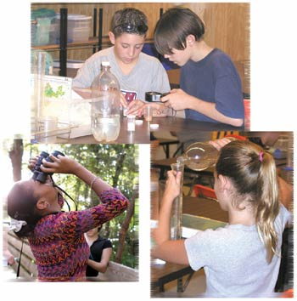

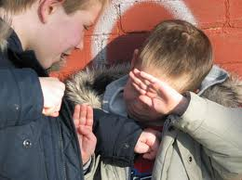
Notes:
goal is to include all students, not have them change their behavior to fit into our circle, but to widen the circle to include then diverse needs of more students

Slide 9

SOCIAL CULTURAL SHIFTS
A shift in how we think, feel and act
FROM
Reactionary
TO
Prevention
Notes:
The fundamental purpose of PBIS is to make schools more effective and equitable learning environments through establishing safe, positive and predictable behaviors. To make this happen, there must be a personal shift in our thinking, feelings and actions.
From looking for what they are doing wrong to looking for what they are doing right

Slide 10
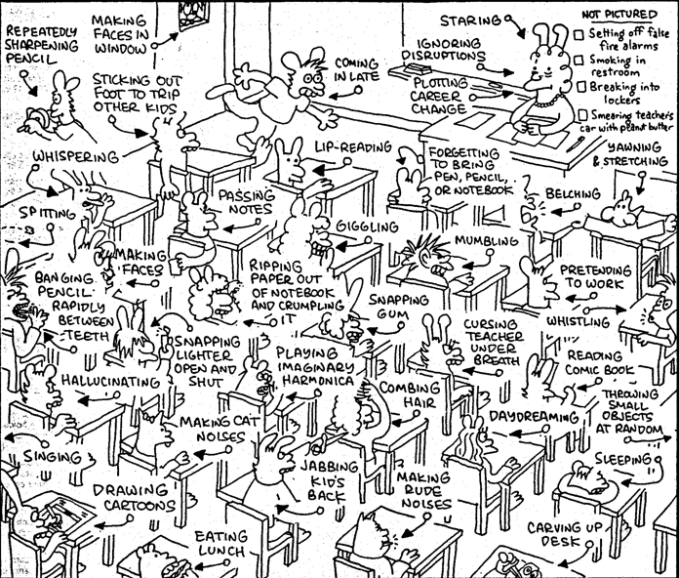
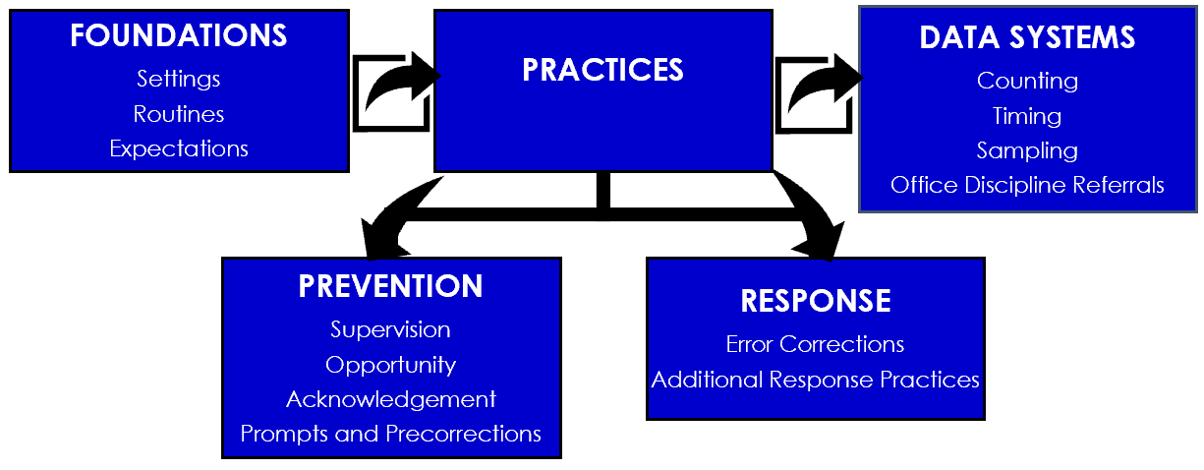

Slide 11

SOCIAL CULTURAL SHIFTS
A shift in how we think, feel and act
FROM
Punitive
TO
Disciplinary
Notes:
The fundamental purpose of PBIS is to make schools more effective and equitable learning environments through establishing safe, positive and predictable behaviors. To make this happen, there must be a personal shift in our thinking, feelings and actions.
From looking for what they are doing wrong to looking for what they are doing right

Slide 12

Behavioral Science
ANTECEDENTS “Prevent” | BEHAVIOR “Teach” | CONSEQUENCE “Reinforce” “Respond”
Design supportive environments using antecedent strategies promoting a positive and safe school climate and classroom. | Teach positive expectations, self-management and social appropriate peer interactions supporting a positive and safe school climate and classroom for ALL students. | Provide a continuum of positive, intrinsically motivating feedback responses and error correction for ALL students that encourages socially appropriate behaviors.

Slide 13
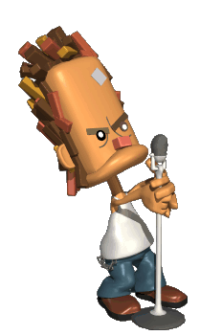
CULTURAL SHIFTS
A shift in how we think, feel and act
FROM
“What we do to them.”
TO
“What we do with them.”
Notes:
The fundamental purpose of PBIS is to make schools more effective and equitable learning environments through establishing safe, positive and predictable behaviors. To make this happen, there must be a personal shift in our thinking, feelings and actions.
From looking for what they are doing wrong to looking for what they are doing right

Slide 14


#2
Designing Your Classroom Matrix
STEP 1: Frame it
STEP 2: Doing it together
Guidelines: | This means: | Example: | Non-example:
Observable | I can see it | Raise hand and wait to be called on | Be your best
Measurable | I can count it | Bring materials | Be ready to learn
Positively Stated | I tell students what TO do | Hands and feet to self | No fighting
Understandable | The vocabulary is appropriate for age/grade level | Hands and feet to self | Maintain personal space (K_1 rule) *children this age do not have a concept of “personal space.”
Always Applicable | I am able to consistently enforce | Stay in assigned area | Remain seated until given permission to leave

Slide 15

CULTURAL SHIFTS
A shift in how we think, feel and act
FROM
Changing the Student
TO
Changing the Environment
Notes:
The fundamental purpose of PBIS is to make schools more effective and equitable learning environments through establishing safe, positive and predictable behaviors. To make this happen, there must be a personal shift in our thinking, feelings and actions.
From looking for what they are doing wrong to looking for what they are doing right

Slide 16


T

Slide 17

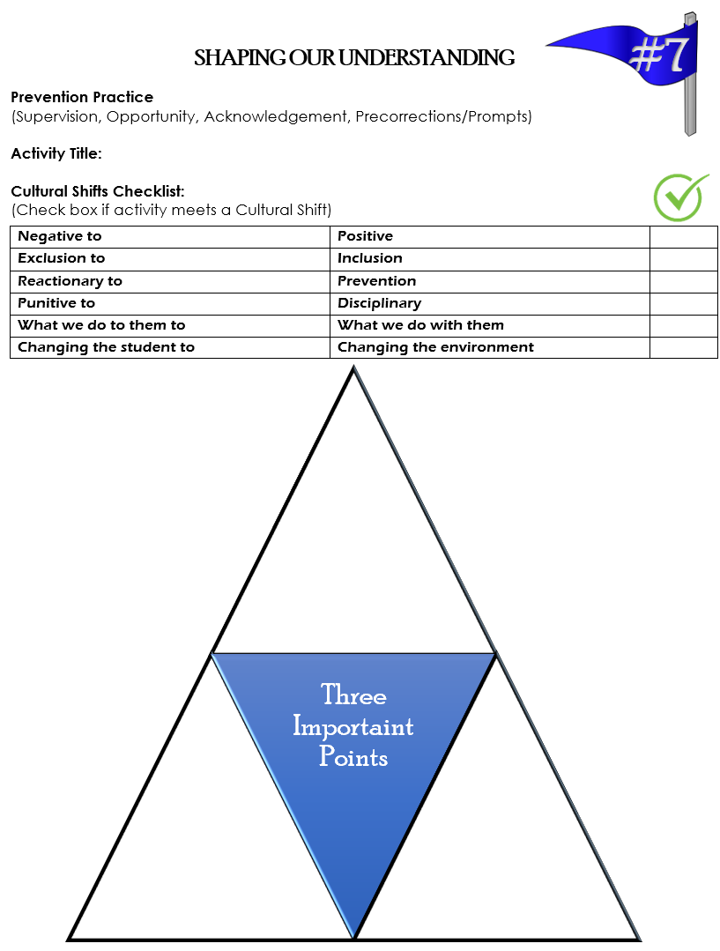

“Diving Deeper” Prevention Practices
Active Supervision in the Classroom Circulating/Scanning/ Encouraging/Choices
Specific Positive Acknowledgement What would you say when…
Positive Teacher-Student Interactions Three Types of Feedback
Page 19
#3
Page 11-12
#4
Page 13
#5
Page 15-16

Slide 18
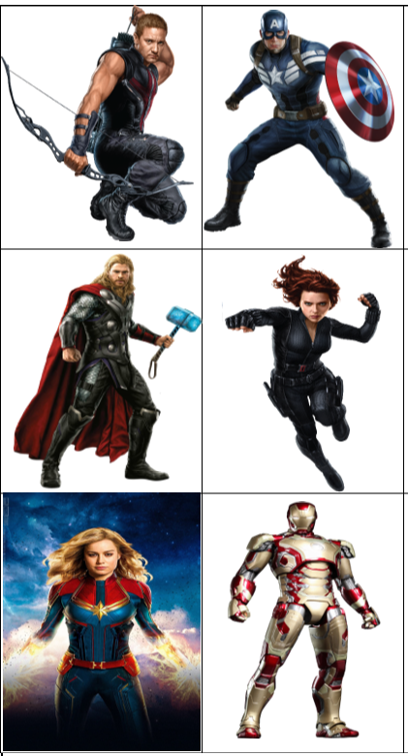
Super Hero Assignments
STACK & PACK
Active Supervision in the Classroom Circulating/Scanning/ Encouraging/Choices
Specific Positive Acknowledgement What would you say when…
Positive Teacher-Student Interactions Three Types of Feedback

Slide 19

Super Hero Assignments
STACK & PACK
Active Supervision in the Classroom Circulating/Scanning/ Encouraging/Choices
Specific Positive Acknowledgement What would you say when…
Positive Teacher-Student Interactions Three Types of Feedback

Slide 20

Break Time

Slide 21
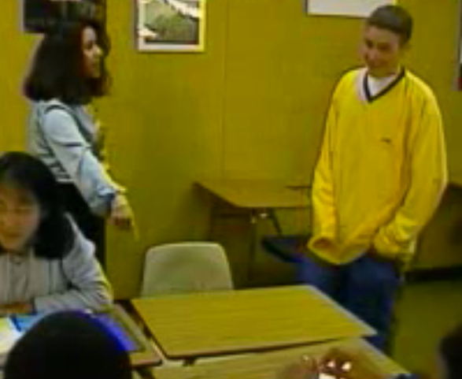
RESPONSE PRACTICES:
ERROR CORRECTION
Use brief, contingent, and specific error corrections
PBISCalTAC.org ->Resources -> YouTube Channel -> PBIS in the Classroom (Staying On Task1)
PBISCalTAC.org ->Resources -> YouTube Channel -> PBIS in the Classroom (Staying On Task2)
Notes:
An informative statement, typically provided by the teacher, that is given when an undesired behavior occurs, states the observed behavior, and tells the student exactly what the student should do in the future
Delivered in a brief, concise, calm, and respectful manner, typically in private
Pair with specific contingent praise after the student engages in appropriate behavior
Disengage at end of error correction and redirection—avoid “power struggles

Slide 22

ERROR CORRECTION Use brief, contingent, and specific error corrections
To effectively correct a social learning error staff should respond in a way that is: Calm – using professional and composed voice tone and volume Consistent – respond each time a social learning error takes place Brief – short and concise response and disengage quickly Immediate – respond within a short time after the social learning error takes place Respectful – polite response free of sarcasm, given in private Specific – identify the observable behavior violation from your school-wide matrix
An effective school-wide continuum of response strategies to problem behaviors should include: Prompt – a visual or verbal cue to signal the occurrence of the desired behavior Redirect – restate the desired behavior from the behavioral matrix Re-teach – tell, show, practice and acknowledge the desired behavior Provide choice – give the student options of desired behaviors Conference with the student – have a private conversation and problem solve together how the student can meet the expectations
#1

Slide 23
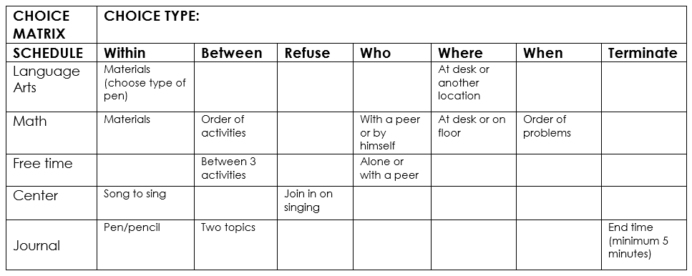

Seven Categories of CHOICE Making

Slide 24


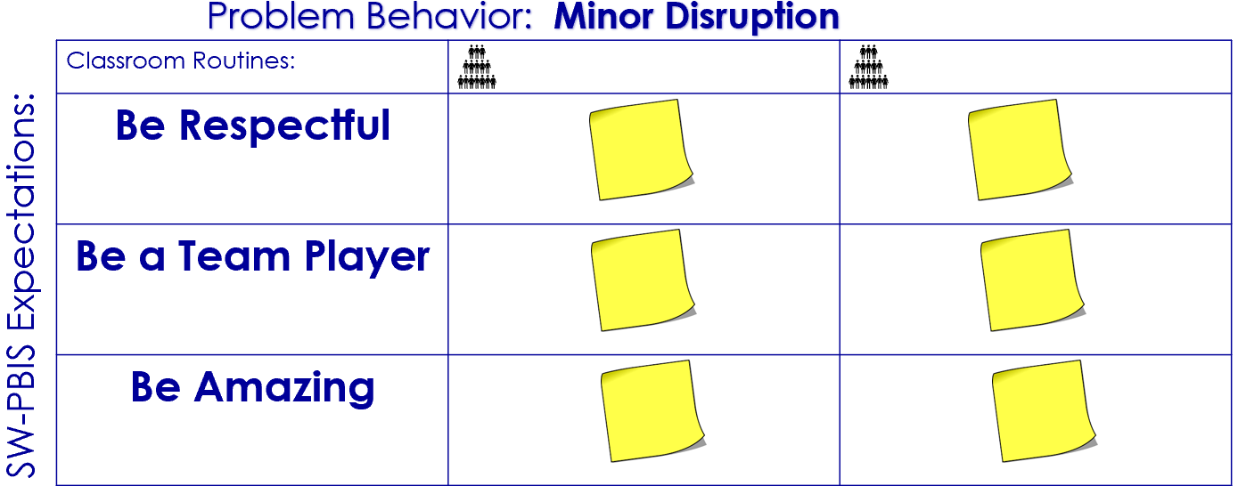

Step 1: Create a classroom routine matrix
Operationalize one social skill for each identified routine.
Write your social skill on a post it and place it on the group matrix.
#1
RESPONSE SCRIPT
Error
Correction
Use brief, contingent, and specific error corrections.

Slide 25


RESPONSE SCRIPT: PRACTICE ACTIVITY
Step 1: Create a classroom routine matrix
Use 3 SWPBIS positive behavioral expectations and write on matrix.
Place your post-it on the group-created matrix.
#1
Problem Behavior: Minor Disruption
Classroom Routines:
Be Respectful
Be a Team Player
Be Amazing
SW-PBIS Expectations:

Slide 26
Step 2: Create a scenario script of response practices to a minor misbehavior
Use error correction and the language found on the classroom routine matrix to create your script. Be prepared to act out your scenario.
.
#1
RESPONSE SCRIPT
Error
Correction
Use brief, contingent, and specific error corrections.
Procedure | Response Strategy Examples
Prompt
Redirect
Re-teach
Provide choice
Conference with the student

Slide 27
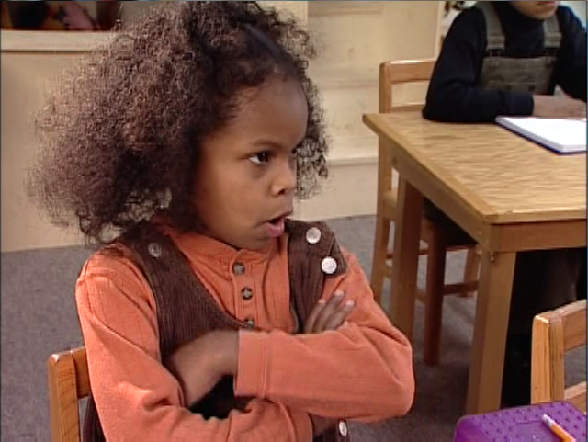
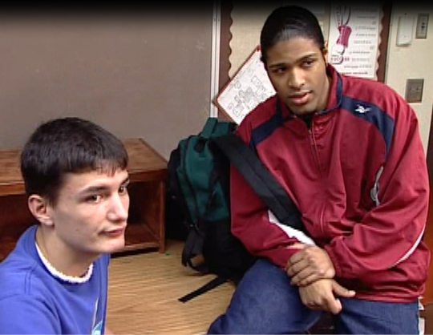

Responding to Non-Compliance
Set of behaviors that teachers refer to as defiance, resistance to directions,
not minding, insubordination, and oppositional.
“Non-compliant behavior in the classroom has been the overall highest ranking reason for
office discipline referrals for
grades 1-12”
Notes:
Facilitator: use the pictures to help explain what non-compliance is.
Those set of low-level behaviors teachers refer to as defiance, resistance to directions, not-minding, insubordination, and oppositional.
The work in Step 7 will help you develop agreed upon definitions of non-compliance(Defiance) and disruption
Planning for these behaviors in your lesson plan will support you when the problem behavior arises. You need to practice this when not upset-so when it happens you can respond with your head and not your gut.

Slide 28
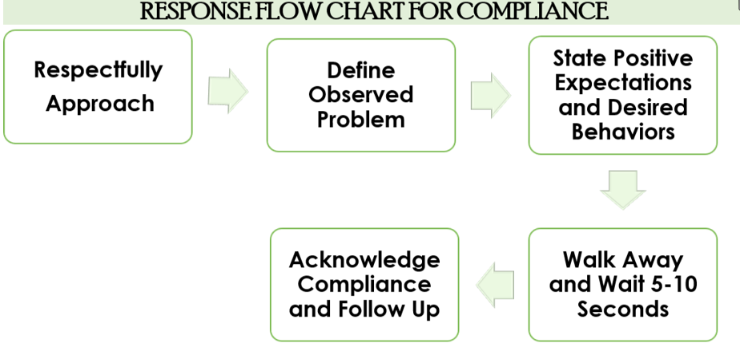
Responding to Minor
Noncompliant Behavior
#2
RESPONSE PRACTICES
Error
Correction
Use brief, contingent, and specific error corrections.
Procedure | Response Strategy Examples
Respectfully Approach
Define Observed Problem
State Positive Expectations and Desired Behaviors
Acknowledge Compliance and Follow Up

Slide 29
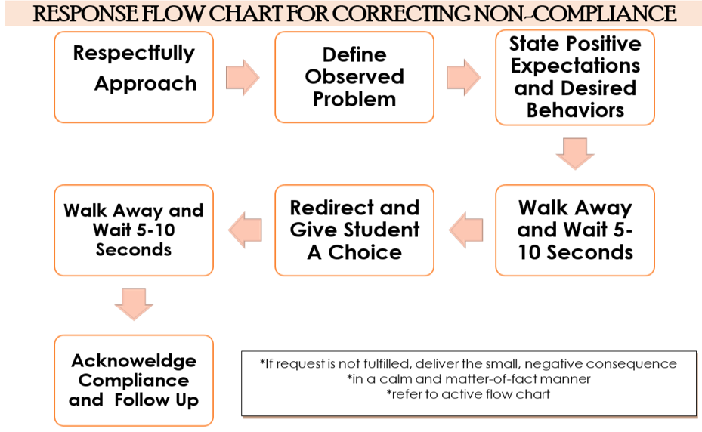
Responding to Minor
Noncompliant Behavior
#2
RESPONSE PRACTICES
Error
Correction
Use brief, contingent, and specific error corrections.
Procedure | Response Strategy Examples
Respectfully Approach
Define Observed Problem
State Positive Expectations and Desired Behaviors
Redirect and Give Student a Choice
Acknowledge Compliance and Follow Up

Slide 30
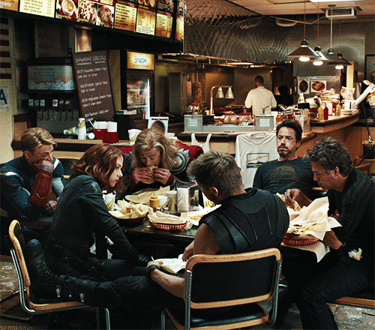
Lunch Time

Slide 31
“General education teachers have to deal with ever increasing numbers of students who are difficult to manage and teach.
In addition, teachers are discovering that the management practices that have worked so well over the years with typical students do not seem to be very effective with these more difficult students.”
Colvin, 2004
Notes:
Many teachers feel that too much time is devoted to students who have behavioral challenges. We must stress that working to prevent challenging behavior improves the school climate and provides educational benefit for all students. Read the slide or direct participants to read the slide, then say, “Managing challenging behavior relieves stress within the entire school culture, provides more focused instructional time and increases the likelihood all our children will achieve academic and social success!”
“ ‘The focus of PBS is on assisting the school to achieve broad changes that facilitate more positive outcomes for all participants in the system. In this light, the reduction of challenging behaviors is viewed as an important . . . goal that is of value primarily because of its . . . effect on producing meaningful lifestyle and cultural changes that are stable and enduring.’ ” Carr, E.G., Dunlap, G., Horner, R.H., Koegel, R.L., Turnbull, A., Sailor, W., Anderson, J., Albin, R.W. & Fox, L. Positive behavior support: Evolution of an applied science. Retrieved Nov. 26, 2013 from http:www.apbs.org/files/pbsevolutions.pdf

Slide 32
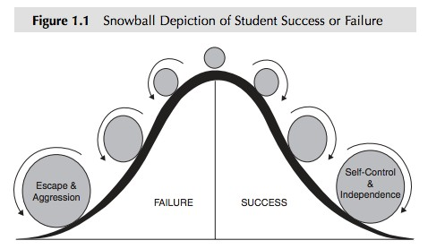
“THE SNOWBALL ROLLING FAST TO THE RIGHT CANNOT BE SLOWED BY THE OCCASIONAL FAILURE. LIKEWISE,
THE SNOWBALL ROLLING FAST TO THE LEFT WILL NOT
BE SLOWED BY THE OCCASIONAL SUCCESS.”

Slide 33

Human behavior is functional.
Behavior serves a purpose
Results/consequences of a behavior affect future occurrences of that behavior.
Principle #1

Slide 34

Function of Behavior
Behavior
Obtain/Get Something
Avoid/Escape Something
Stimulation/ Sensory
Social
Tangible/ Activity
Adult
Peer

Slide 35
Human behavior is predictable.
Environmental conditions can set up, set off, or maintain appropriate or inappropriate behavior.
Principle #2

Slide 36
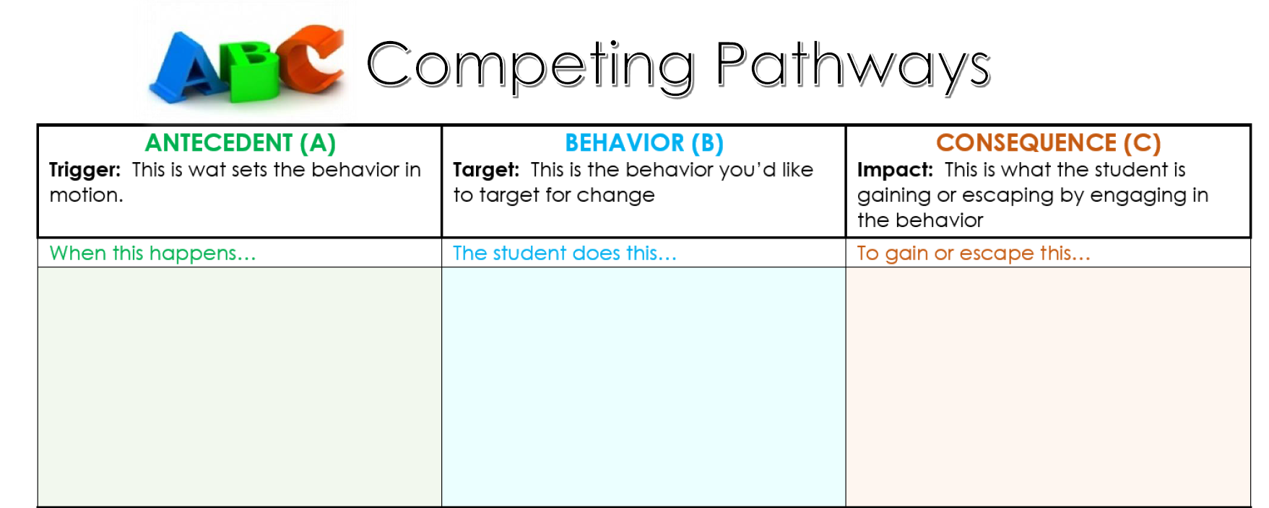
what

Slide 38
Human behavior is changeable.
Understanding the predictors, consequences and function of problem behavior is key for designing effective interventions.
Principle #3

Slide 39
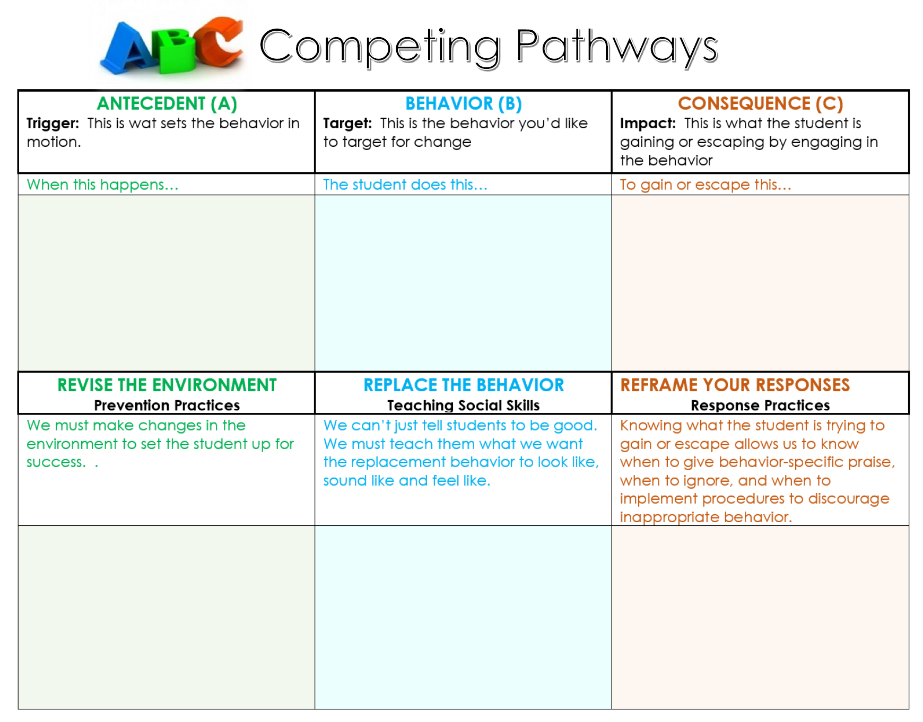
what

Slide 40
“Unfortunately, most of the practical techniques used by teachers to respond to acting-out youth are only of limited effectiveness and some, such as reprimands, arguing, and escalated hostile interactions, can actually strengthen the behaviors they are intended to suppress or terminate.”
Hill Walker, The Acting-Out Child: Coping With Classroom Disruption
Notes:
Presenter
2017-05-24 21:48:55
--------------------------------------------
Direct participants to read the Hill Walker quote, then say, “Please, turn to a shoulder partner and share your thoughts regarding the meaning of this quote.” Provide approximately 1 minute for the discussion, then say,
“. . . the number one reason that teachers do not deal with or overlook problem behavior is an uncertainty of WHAT to do. Many of the techniques used by teachers–including reprimands, raised voices, threats, or even ignoring the behavior–actually may, inadvertently, be strengthening the problem behavior.” “We’ll first focus on what we can do to PREVENT defiant and noncompliant behavior.”

Slide 41
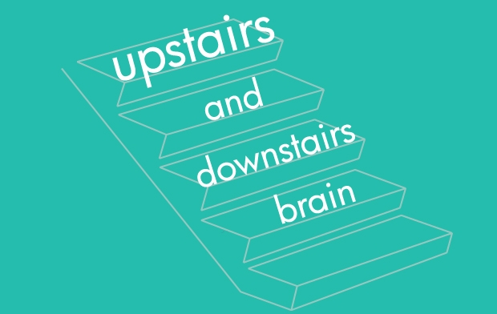
Upstairs/Downstairs Brain
PBISCalTAC.org -> Resources -> YouTube Channel -> PBIS in the
Classroom
Notes:
Say, “So why do these children have difficulty expressing emotions when they are frustrated or angry?” “Epinephrine and norepinephrine - are released by the adrenal medulla and sympathetic nerve endings in response to fear and anger. These are also called ‘fight or flight’ hormones. Lots of glucose is generated, but not for use by the brain primarily, but by muscle. Since the brain is used to avoid a confrontation like this, the body has bypassed the thinking organ and increased the energy at the working organs; thus, a person who is experiencing anger, fear or frustration is not operating in the part of the thinking part of the brain.”

Slide 42

The Acting Out Cycle
Acting out behavioral cycle is defined in seven phases.
Specific features at each phase should allow staff some predictability in planning for students.
Our goal is to interrupt the student’s cycle.
Notes:
, “The Acting-Out Cycle provides a model to represent behaviors in an escalating chain. Using this model can assist school teams to develop procedures to respond to students who engage in acting-out behavior.”
The acting-out cycle is proposed by Geoff Colvin and Hill Walker out of the University of Oregon, and it’s a really wonderful theoretical illustration about how problem behaviors occur. A lot of times teachers will say, “This child just started screaming out of control,” or, “This child just blatantly refused to do their work or just stormed out of the room for apparently no reason.” And what they’ve shown through this acting-out cycle is that behavior actually does occur in a chain and that what most teachers are noticing are either peak behaviors where kids are completely out of control either throwing a chair or using profanity or being verbally or physically aggressive or sometimes they know earlier symptoms. But, in general, teachers haven’t been taught that behavior problems or concerns actually happen much, much earlier within the cycle.

Slide 43

Behavioral Chain
In order to control a behavioral chain, the links need to be identified and broken.
Teacher assigns task.
Student says,“I hate this!”
Teacher says,“You have to do it before you go to recess.”
Student rips up assignment.
Teacher says,“You’ll have to go to the office.”
Student crawls under the desk.
Notes:
“We must respond quickly and calmly to provide assistance when a child makes a social behavioral error to prevent the likelihood that misbehaviors will escalate into more disruptive behavior.”
Ask participants to recall a recent teacher-student behavior chain, then say, “Describe what you believe could have been done differently to “break the chain.”
Series of stimuli/response reactions
Effective management of behaviors during early phases will reduce the likelihood the later phases when the more serious behaviors will occur.
Each behavior needs to be prompted by a preceding behavior. If the preceding behavior is not present, or interrupted, the next behavior will not occur. How can we develop an effective system to break the escalating chain of behavior?”
Identify how to accurately assess in which phase the student is operating.
Identify environmental supports that can be provided to intervene early in the escalation.
Identify replacement behaviors that can be taught & serve similar function.

Slide 44
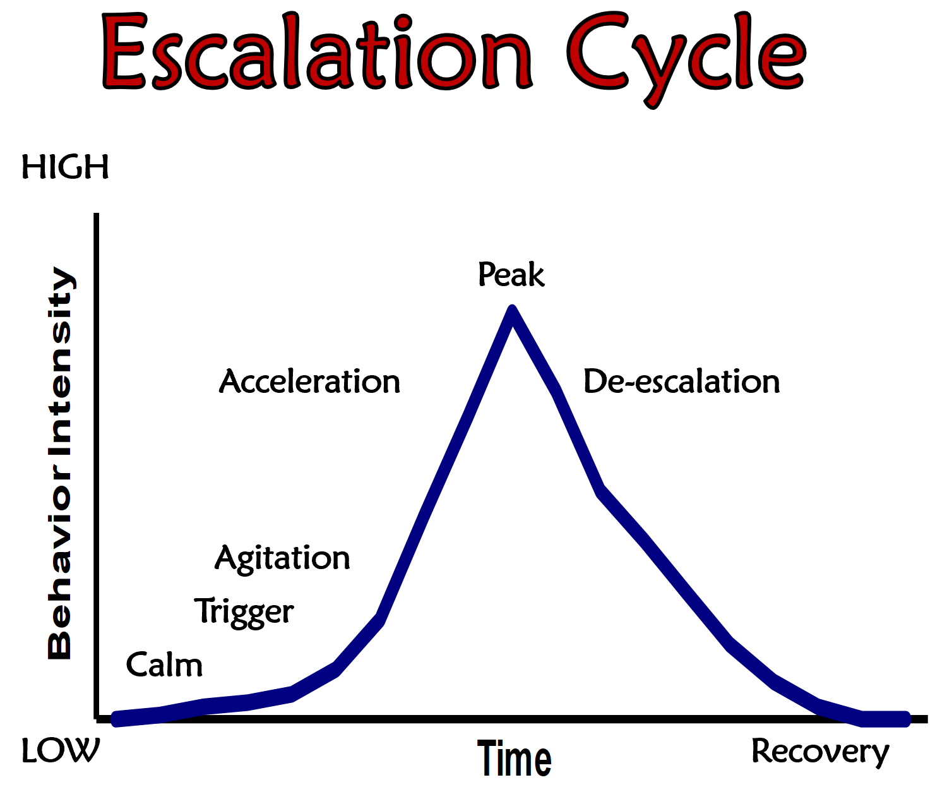

A Seven Phase Cycle
Calm
Triggers
Agitation
Acceleration
Peak
De-escalation
Recovery
Notes:
The cycle generally begins with this Calm Stage. And, although not every child comes to school calm, we’d think at some point in their life they have some calm experience. And then something sets that child off, and that’s called a trigger. And sometimes those are school-based things, like assemblies or a schedule change or being given a difficult assignment, something like that. Or it can be nonschool-based. It could be coming to school tired or hungry or having had an argument with your parents before you get there. And then, if those triggers aren’t noticed, then the behavior will move from signs of agitation to acceleration. And then acceleration can last for kind of a long phase. And then it will continue to escalate if it’s not nipped in the bud right there, and then eventually the behavior peaks out. Then there is a de-escalation and then a recovery. So it kind of looks like you are climbing a mountain. You’re going up and then down.

Slide 45
Dealing with
Acting Out Behaviors
ASSUMPTIONS:
I can’t let a student get away with this.
What will the other students think?
I need to establish authority.
I need to settle down agitated students.
I need to be in control.

Slide 46
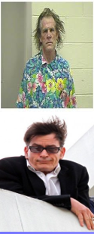


Signs of ESCALATION

Slide 48

Phase 1: CALM
Students exhibit appropriate, cooperative behavior and are responsive to staff directions.
Create positive environment to increase appropriate behavior. Arrange for high rates of successful academic and social engagements. Teach Social Skills Problem solving Self-management and relaxation strategies Assess Problem Behavior Examine academic and behavioral learning history Identify triggers and the function | What classroom practices do you have in place to create a calm environment? How do you know? FOUNDATIONS INSTRUCTIONAL PRACTICES
Notes:
I would say that the very best discipline plan is a good lesson plan. And, really, it’s being attentive during this time. It’s providing children with both contingent and noncontingent attention. Most of us are learning about contingent attention: That when a child does something good, like when they complete their work or when they earn an A or when they do something nice for another child, we as teachers are trained to recognize that and say something very specific like, “I appreciated the fact you shared your eraser with Johnny because he had a problem and didn’t have an eraser.” But there’s also, during this Calm Phase, another way of maintaining that is just by offering children noncontingent attention. That just by virtue of being in your classroom there’s going to be some dialogue, some interaction. Whether you greet them at the door, and it doesn’t even have to be a compliment, it’s, “Hey, you know, I missed you yesterday,” or, “What’s going on? What’s going on with your family?” or, “Did you notice I did this new bulletin board?” Just something so they can recognize that you are a human being and you value them as a human being. And it creates this, again, calm, supportive, instructionally focused classroom.“To all outward appearances, their behavior is appropriate, generally cooperative, and responsive to the teacher’s directions and expectations.” (Colvin, 2004)
In the Calm Phase, student behavior is characterized as goal-directed, compliant, cooperative, and academically engaged. Students are responsive to teacher praise and are receptive to working with their peers. Overall, students are behaving in accordance with the guidelines specified in the classroom management plan.
One of the best ways to prevent problem behaviors from occurring is to keep students in the Calm Phase. This can be done by:
Creating a sound classroom structure of a kind specified in your classroom management plan
Explicitly teaching social and behavioral expectations to students
Giving students sufficient levels of attention for meeting your expectations

Slide 49
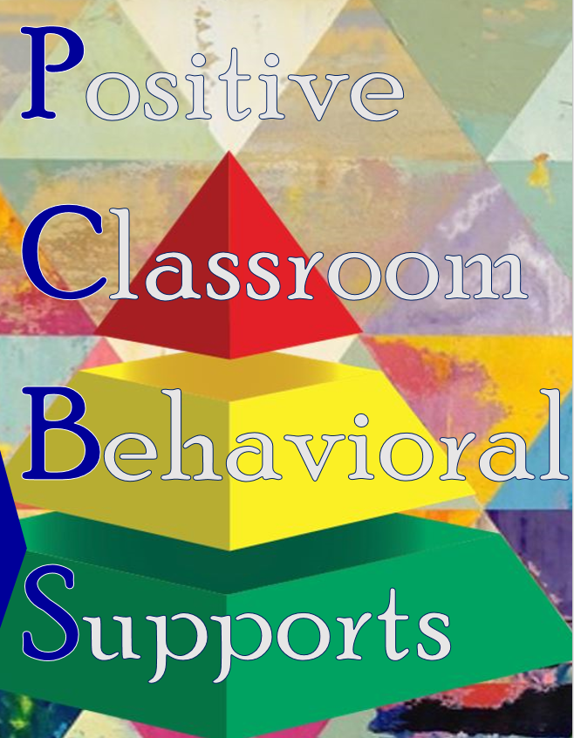
Positive Classroom Behavioral Supports Self-Assessment Survey Adapted from Supporting and Responding to Behavior PBIS Technical Brief on Classroom PBIS Strategies 1) I never have heard of this practice. 2) I have implemented this practice, but I am inconsistent. 3) I implement this practice regularly in my classroom. 4) I implement this practice regularly and I am interested in how others are implementing the practice.
Classroom Supports | Evidence-based Practices | Scale of 1-4
FOUNDATIONS Settings Routines Expectations | SETTINGS: I effectively design the physical environment of my classroom. ROUTINES: I develop and teach predictable classroom routines. EXPECTATIONS: I post, define and teach 3 to 5 positive classroom expectations.

Slide 50
Positive Classroom Behavioral Supports Self-Assessment Survey Adapted from Supporting and Responding to Behavior PBIS Technical Brief on Classroom PBIS Strategies 1) I never have heard of this practice. 2) I have implemented this practice, but I am inconsistent. 3) I implement this practice regularly in my classroom. 4) I implement this practice regularly and I am interested in how others are implementing the practice.
Classroom Supports | Evidence-based Practices | SCALE OF 1-4
INSTRUCTIONAL PRACTICES Pacing Sequencing Choice | PACING: I allow for positive behavioral momentum beginning, during and/or ending an academic task. SEQUENCING: I consider pace, sequence and level of task difficulty when promoting each students’ success. CHOICE: I consider a variety of methods when offering student choice.

Slide 51

Docent Display
Title Phase:
Description & Visual Display:
Proactive Strategies:
Phase 5:
Phase 6:
Phase 7:
Phase 2:
Phase 3:
Phase 4:
Foundation | Prevention Practices | Response Practices

Slide 52
Phase 2: Triggers
Triggers are activities, events, or behaviors that provoke anxiety and set off the cycle of problem behavior.
Intervention: focus on prevention & redirection
Pre-correct before triggers are present. Identify the content and predictable problem behavior Provide Active Supervision Specify expected behavior Rehearse/practice expectations | Increasing opportunities for success. Reinforcing what has been taught. Teaching social skills for managing triggers. Considering function of problem behavior in planning and implementing response.
Notes:
“Triggers are defined as those events that set off the cycle of acting out behavior. Other names for triggers include: antecedents, aversive stimuli or negative circumstances.”
During the Trigger Phase, student misbehavior can be triggered by a concern that is left unaddressed. Such concerns can take place either within or beyond the school day.
School-based triggers may include:
A negative interaction with a teacher
An argument with a peer
A change in the daily schedule (e.g., an assembly)
High rate of failure on an academic task
Confusion about an assignment
Nonschool-based triggers may include:
Hunger
Lack of sleep
Medical problems
Stressful home situations
Fortunately, teachers can use formal problem-solving strategies and precorrection plans to help students anticipate and prevent, or effectively respond to, these triggers to prevent behavior from escalating into more serious phases of the acting-out cycle

Slide 53
Positive Classroom Behavioral Supports Self-Assessment Survey Adapted from Supporting and Responding to Behavior PBIS Technical Brief on Classroom PBIS Strategies 1) I never have heard of this practice. 2) I have implemented this practice, but I am inconsistent. 3) I implement this practice regularly in my classroom. 4) I implement this practice regularly and I am interested in how others are implementing the practice.
Classroom Supports | Evidence-based Practices | SCALE OF 1-4
PREVENTION PRACTICES Supervision Opportunity Acknowledgement Prompts & Precorrections | SUPERVISION: I use active supervision and proximity. OPPORTUNITY: I provide high rates and varied opportunities to respond. ACKNOWLEDGEMENT: I use behavior specific praise. PROMPTS & PRECORRECTIONS: I make the problem behavior irrelevant with anticipation and reminders.

Slide 54
Phase 3: Agitation
Characterized by emotional responses (e.g., anger, depression, worry, anxiety, and frustration.)
Intervention: focus on reducing anxiety
Teacher Proximity Independent Activities Passive Activities Movement Activities Academic lesson is not priority at this time; moving student back to calm phase is primary goal. | Calming Strategies Teacher Empathy “Are you ok?”“Is there something I can help you with?”“Do you need a minute to yourself?” Assist Student to work on the Task Provide Space Provide Assurances and Additional Time Permit Preferred Activities (within set parameters)
Notes:
The Agitation Phase is often rather long. In general, behavior is unfocused. Some students demonstrate agitation by increasing behaviors such as darting their eyes or tapping their hands, moving in and out of groups, and starting and stopping activities. In contrast, other students decrease movement by disengaging from groups, staring off into space, or lowering their involvement in instructional activities. Both are evidence that they have disconnected from the learning experience.
It is imperative that teachers identify and interrupt the acting-out cycle during, or preferably before, the Agitation Phase. If the cycle is not stopped, student behavior will likely increase to more severe forms of behavior such as verbal and physical aggression.
Once you see these symptoms of agitation, there’s a couple of different strategies…and it’s important that you use these early on in this phase, because if they’re used later in the phase it could set the child off, to set them into the next stage of the acting-out cycle. But one approach is just to simply say, “It seems like you’re struggling right now and having a hard time staying on task,” or, “How can help you?”, “Would you like to go take your assignment and work in the back of the classroom?” or, “I’ve got this other area over here. Why don’t you move over here? Would you like to work with a partner on this?” So it’s before the behaviors become out of control. Because you don’t want to reinforce out-of-control behavior, but when you’re seeing that they’re struggling, they may not even be realizing yet that they’re having a hard time. Or sometimes you don’t ask them, you just simply say, “At this point we’re going to go ahead and grab a partner to finish up the last half of the activity and check your work, so I’d like you…” and then you’d number all of the children off, “One, two, one, two.” You kind of pair the kids up. But you need to shift something that’s happening in your instruction, and it doesn’t necessarily always have to be a change for the whole class. But, typically, if you have a child that’s disengaging like that, that’s not going to be the only child. And, as a teacher, hopefully you’re strong enough in your instruction and your talent to realize that, Maybe it’s time for me to shift something that I’m doing rather than it being a “within child” problem; it could be an instructional problem. So you would shift in that method. It’s much like wearing a necklace, like if you have a pearl necklace. Each little link is attached to the next, and all you have to do to stop the behavior problem from running the whole chain of your necklace, if you will, is cut it at one point. And it’s much easier to do that either at the Trigger Stage or the Agitation Phase. Because at that point, the discrepancy between where the behavior is and where the behavior you want it to be is so narrow that it’s much easier to get the kids back on track at that point.

Slide 55
Positive Classroom Behavioral Supports Self-Assessment Survey Adapted from Supporting and Responding to Behavior PBIS Technical Brief on Classroom PBIS Strategies 1) I never have heard of this practice. 2) I have implemented this practice, but I am inconsistent. 3) I implement this practice regularly in my classroom. 4) I implement this practice regularly and I am interested in how others are implementing the practice.
Classroom Supports | Evidence-based Practices | SCALE OF 1-4
RESPONSE PRACTICES Error Correction Planned Ignoring Function-based Thinking | Error Correction: I use brief, contingent, and specific error corrections to respond to problem behaviors. Error Correction: I respond to misbehavior accurately, specifically and in a timely manner. Planned Ignoring: I systematically withhold attention from a student when they exhibit minor misbehaviors for peer attention. F-B Thinking: I respond to behavior in a way that tries to address the reason or purpose why the student misbehaves.

Slide 56
Phase 4: Acceleration
Escalated behaviors intended to test limits. Students exhibit engaging behavior that is highly likely to obtain a response from another person – typically the teacher.
Intervention: Focus on Safety
Move slowly and deliberately toward the problem situation. Speak privately if possible. Minimize body language. Keep a reasonable distance. Speak respectfully. Use non-confrontational limit-setting procedures | Non-confrontational limit-setting procedures Establish Initial Setup Rehearse the Steps with the Class Establish a short list of Negative Consequences Present the Information as a Decision Follow – Through Acknowledge when the student begins to engage in appropriate behavior Calmly and quietly administer negative consequence when the student continues problem behavior
Notes:
During the Acceleration Phase, student behavior becomes more focused in an effort to engage the teacher. Specifically, students use a variety of behaviors (e.g., questioning, arguing, refusing to work, committing minor property destruction) to engage the teacher and interfere with instruction. Sometimes students will complete the required assignments but will produce poor-quality work or will complete only a portion of the assignment. Although the Acceleration Phase is in the middle of the acting-out behavior cycle, indicating that the behavioral concern has been building for some time, this is often when teachers first recognize that a problem is occurring
“Triggers are defined as those events that set off the cycle of acting out behavior. Other names for triggers include: antecedents, aversive stimuli or negative circumstances.”
Typically, without any kind of awareness training about the acting-out cycle, this is where teachers will notice that there’s a problem for the first time, and this is when the kid is trying to take you on. They’re making statements to try to engage you in an argument. It’s like, “This is so boring. I did this when I was in third grade. I cannot believe I have to do this again.” They’re trying to provoke you as a teacher. And your typical response is to say, you know, “You need to do this because I told you this is what needs to be done.” And then you find yourself engaged in an argument with a 12-year-old. But at this point, it’s critical that you not engage in sarcasm and that you allow the child time to kind of manage their behavior. And so you need to be able to say things like, “I know you’re upset right now, but I really need you to start these problems.” And maybe your intervention, at that point, is a highlighter. You underline the first three problems and you say, “When you get these three done, please check them with a partner, and I’ll be right back to check on you after that.” And they will probably make a comment when you walk away, but that’s not the time to deal with that comment. You’re going to have to lose the battle to win the war kind of a thing. Because if you engage them then you will propel them into the next stage. And another symptom that is going to show up for this is that a lot of kids will do partial compliance during this time. So if you tell them to do the assignment, they’ll do it in a very, very sloppy or rushed way and just turn it in and think that’s good enough. And sometimes as the teacher, and this is hard to do, you’re going to have to just say, “Okay, I appreciate that. However, this last one is so unreadable. I can’t do this, so please erase just this last one and finish it.” But if you told him to go back and re-do that whole assignment at that moment, you would push them over the edge.
Interviewer: So, in summary, the best way a teacher can interrupt the Acceleration Phase is to…
Kathleen Lane: Offer a prompt and walk away. Make the request known, and then give the child the opportunity to respond. And then give them immediate reinforcement as soon as you see them engage: “I really appreciate you getting back on track. That’s great.”

Slide 57
Positive Classroom Behavioral Supports Self-Assessment Survey Adapted from Supporting and Responding to Behavior PBIS Technical Brief on Classroom PBIS Strategies 1) I never have heard of this practice. 2) I have implemented this practice, but I am inconsistent. 3) I implement this practice regularly in my classroom. 4) I implement this practice regularly and I am interested in how others are implementing the practice.
Classroom Supports | Evidence-based Practices | SCALE OF 1-4
RESPONSE PRACTICES Error Correction Planned Ignoring Function-based Thinking | Error Correction: I use brief, contingent, and specific error corrections to respond to problem behaviors. Error Correction: I respond to misbehavior accurately, specifically and in a timely manner. Planned Ignoring: I systematically withhold attention from a student when they exhibit minor misbehaviors for peer attention. F-B Thinking: I respond to behavior in a way that tries to address the reason or purpose why the student misbehaves.

Slide 58
Phase 5: Peak
Students with acting-out behavior may be a threat to themselves or others.
Intervention: Implement Safety Plan
Identify behaviors that signal the safety strategies should be used. Describe each action that must be taken to keep everyone safe. Identify the personnel that will assist in implementing the plan. Identify what the other children will do. Have personnel (accessed through a code word over the intercom or accessed by having a responsible child go to the office) and materials (crisis bag) readily available. | Safety strategies are different from response interventions. They should be used only in situations where there is serious risk of injury to self, others, or valuable property. Preliminary data indicate that crisis management procedures are overused and unnecessarily used (George, 2000).
Notes:
During the Peak Phase, behavior is clearly out of control. At this point, prevention of the problem behavior is not possible, and the teacher is forced to deal with it. Students may physically assault others, hurt themselves, cry hysterically, or destroy property–any of which might lead to devastating outcomes. Because the behavior at this point is often loud and explosive and then abruptly ends, the Peak Phase tends to be a short one. However, the aftermath of this critical event, or “behavioral earthquake,” is often quite serious. For obvious reasons, it is best to prevent behaviors from escalating to this point.
The overriding consideration during this Peak Phase of the acting-out cycle is to maintain safety of both the child who is acting out and the other children in the classroom, to ensure that people are not getting hurt. And in order to do that, you need to find out at the onset what is your school’s plan for responding to this type of behavior. And this is specific to every school, as to what you’re supposed to do if a student is completely out-of-control. In some schools, what they’ll do is they will have the students who are in control line up and wait outside the door. Often times they’ll call a vice-principal or some other disciplinary figure to come remove the child who is acting out. So there’s a variety of different methods that respond. And what’s important for the teacher to know ahead of time, before the very first day of school, is find out how does your school want you to respond to those types of problems. Is the goal to keep all the kids in the classroom? Is the goal to remove the child who’s acting out? A lot of schools have a removal policy at that point, where they will send the child to on-campus suspension or phone a parent. The downside of that though, I have to say, is that you are teaching that child that if you act like this, you can escape my classroom. So if the child’s whole goal is to get out of a situation where they are not comfortable—either because they can’t do or don’t want to do what’s taking place in that classroom you’re in danger of reinforcing some very inappropriate behavior. So you have to be careful. Get it over with as quickly as possible, and get out of this phase so that you can restore the environment, debrief the child, and get back on track instructionally. But you have to keep everybody safe.

Slide 59
Phase 6: De-escalation
This phase is characterized by student disengagement and reduced acting-out behavior.
Intervention: focus on removing excess attention
Reduce stimuli and interaction with other people to prevent further escalation and to provide time to calm down Assign low level independent task Emphasize starting anew Avoid blaming Don’t force apology Follow up with the student at another time when the student is perfectly calm | Teacher/Staff Procedures Isolate the student Decision is made to retain student at school or send home Complete exit paper work as appropriate Engage in independent work with clear criteria Determine consequences Restore the environment if appropriate Resume regular schedule
Notes:
When students come out of the Peak Phase, they may be confused, disoriented, and far less agitated. Many students will withdraw, deny any responsibility or involvement, attempt to blame others, and even try to reconcile with those they harmed or offended. Although students will most likely not want to discuss the incident, they are often responsive to directions.
Most likely, during this time, they’re not going to want to talk about the incident. And most oftentimes, teachers don’t want to talk about it because they’re afraid of re-escalating the child. The good thing is, these children are pretty receptive to directions at this point. So you need to figure out a way to give them a way to get out of this with some dignity. So oftentimes what teachers will do is put the child in a different area, not a timeout area, but a separate area in the classroom. Then you give them an independent activity that’s at their instructional level. So it might be a worksheet, it could be writing their spelling words three times each, it could be—at the high school level—it could be a journal: “Go ahead and write about what just happened,” kind of a thing. But it’s a short assignment that removes the child from the attention of the other kids in the classroom. It gives you a couple minutes—not many, two to three—as a teacher to get the other kids back on task and then you can re-approach this child in the next stage

Slide 60
Phase 7: Recovery
Intervention: debrief, facilitate transition & effectively problem solve
Positively reinforce any displays of appropriate behavior. Intervention is focused on re-establishing routine activities. Debrief (after student has been calm at least 20 minutes) Not an aversive consequence No more than 3-5 minutes | Debriefing Plan Identify triggers? What did I do? What new behavior will I learn to respond to triggers? When will I practice my new behavior? Can I do it when I begin to become upset?

Slide 61
“It is always important to remember that “if you inadvertently assist the student to escalate, do not be concerned; you will get another chance to do it right the next time around.”
Colvin, 1989

Slide 62

TIME FOR A BREAK

Slide 63

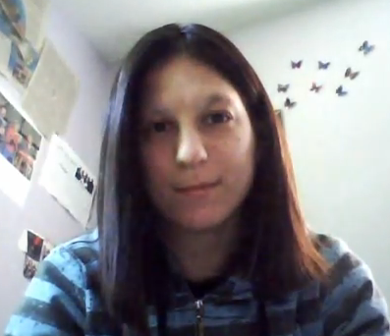
Phases of Meltdowns
The Way I See It!
PBISCalTAC.org -> Resources-> YouTube Channel -> PBIS in the Classroom
Notes:
Major characteristic patterns of behavior commonly exhibited by
students with ASD:
Deficits in social interaction, communication and/or cognitive abilities
Restricted, repetitive patterns of behavior, interests, and activities
Atypical responses to sensory experiences
Physical and emotional health

Slide 64
Six Phases of Meltdowns
HIGH
Meltdown
Re-grouping
Agitation
Trigger
Starting
Over
Calm
LOW
Notes:
CRISTY

Slide 65
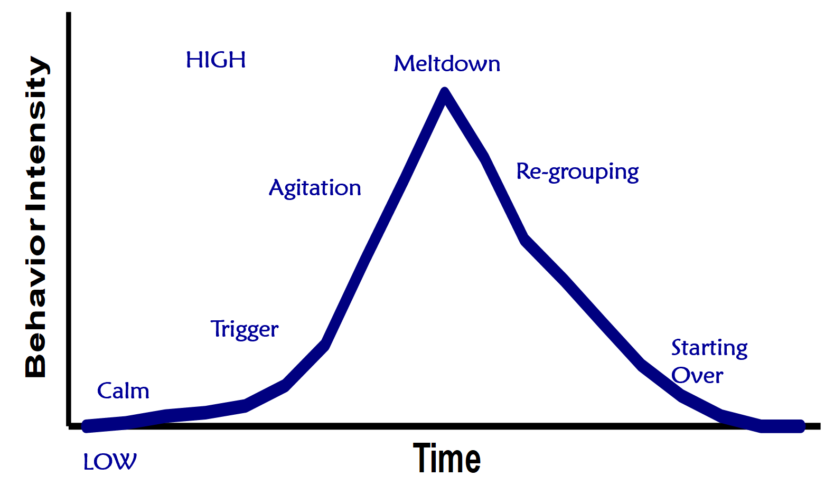
Phase One: Calm Cooperative, focused and acceptable
Description | Interventions
Engages in tasks and activities Follows directions Makes transitions successfully | Classroom structure for all students Attend to sensory adjustments (auditory, visual, gustatory, olfactory) issues. Proprioceptive and position sense – loss balance, bump into walls or crave excessive movement. Challenge INTERNAL. Observe and provide prompts. Use of visual supports (basic communication transitions, needs, teaching rules and expectations) Peer support and peer networks Delivering instruction (direct speech, one modality at a time, skill based curricula)

Slide 66
Phase Two: Triggers Overall student has trouble with understanding and communicating
Description | Interventions
Critical Triggers: Transitions Disruption of schedules and routines Sensory overload and craving | Sensory management Counter the unexpected Rehearse for novel situations Respond quickly to surprises Systematically vary routines Prime desired behaviors Adapt instructional delivery
Notes:
CRISTY

Slide 67
Phase Three: Agitation Overall student exhibits sudden increases or decreases in behavior
Description | Interventions
Increase in Behavior - Externalizing Increases in self-stimulation Repetitive self-talk Low-level destructive behaviors Aimless pacing and wandering Changes in body language Decrease in Behavior - Internalizing Staring into space Becoming mute Withdrawing from activity Seeking isolation | Identify signs of agitation Learn the student’s responses to calming activities (walks, quiet time, visual supports, etc.) Track results (review interventions for Phases 1 and 2 frequently
Notes:
BARB

Slide 68
Phase Four: Meltdown Overall behavior is out of control
Description | Interventions
Serious destruction of property Physical attacks Self-abuse Screaming Running Away | Understand meltdown will run its course Pre-requisite steps Intervention steps a. guide student to safe place b. use supportive measures c. identify signs of emergence from meltdowns d. begin transitions steps (phase 5 – regrouping)
Notes:
BARB

Slide 69
Phase Five: Re-grouping Overall student withdraws and displays confusion
Description | Interventions
Confusion Withdrawal Responsive to manipulative or mechanical tasks Responsiveness to special interests | Involves incremental process Use systematic interactions probes
Notes:
BARB

Slide 70
Phase Six: Starting Over Overall student is responsive to concrete tasks and reluctant to interact
Description | Interventions
Student displays eagerness for independent work or activity Subdued behavior Increased focus Becomes more settled | Provide strong focus on scheduled activities Pay special attention to know triggers (transitions, etc) Develop debriefing plan (if appropriate) Heighten emphasis on skill building Review response plan
Notes:
BARB

Slide 71
Proactive Strategies
FOUNDATIONS | PREVENTION PRACTICES | RESPONSE PRACTICES
Phase 1: Calm
Phase 2: Trigger
Phase 3: Agitation
Phase 4: Meltdown
Phase 5: Regrouping
Phase 6: Starting Over

Slide 72
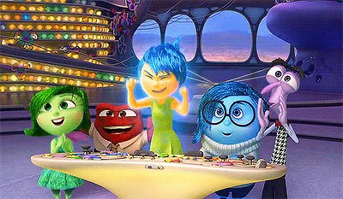
Share Out Your
PROACTIVE STRATEGIES

Slide 73

ONE
WORD

